Slide 1


MSB4182
SOCIAL ENTREPRENEURSHIP
Lesson 7
IDENTIFYING CO-FOUNDERS AND HIRING A TEAM

Slide 2
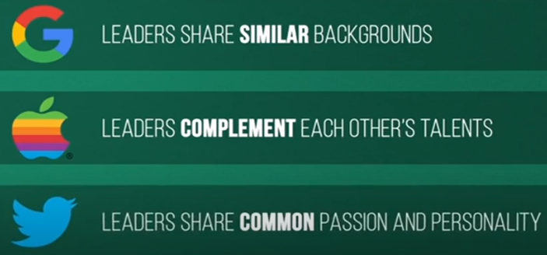
OVERVIEW OF LEADERSHIP
Co-founders of these companies,

Slide 3
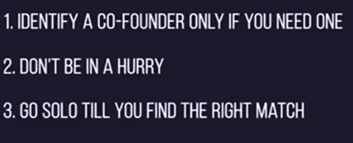
CAUTION

Slide 4


WHY TEAM IS REQUIRED?
True success comes from a team which

Slide 5
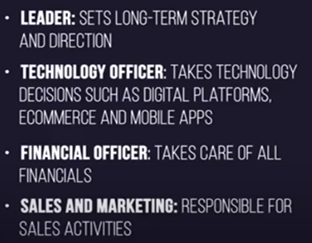

WHY TEAM IS REQUIRED?
Hire appropriate individual for these roles depending on the nature of the startup and the resources that is available
While hiring

Slide 6
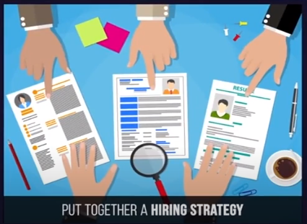
HOW AND WHEN TO HIRE?
Adding a wrong person in a team will hurt, especially in a start up

Slide 7
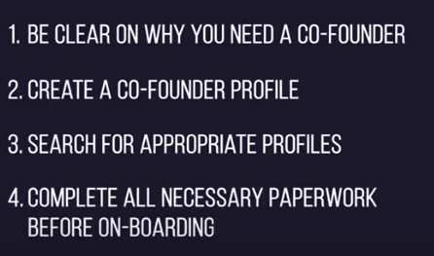
HOW AND WHEN TO HIRE?

Slide 8
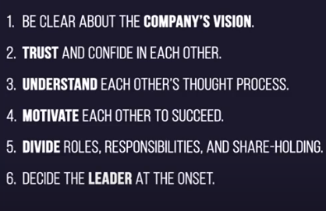
HOW AND WHEN TO HIRE?

Slide 9
HIRING STRATEGY - WHEN
Best hiring strategy is DO NOT HIRE. Delay hiring as long as you can.
Why delay HIRING?
Because hiring a team is a COST to THE COMPANY (CTC)
Hire only if you team is unable or unequipped with the work load

Slide 10
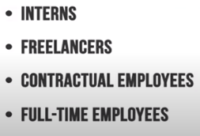
HIRING MODE - HOW
Better to have a limited number of full – time employees in a start-up

Slide 11
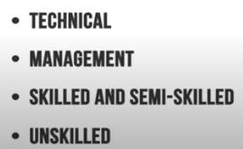
WHOM NEED TO HIRE- TYPICAL SKILL SET
Identify whom a start-up needs, like
Like coders, developers, etc.
To take care of sales and marketing
Welders, drivers, etc.
Hen hiring, identify a employee ho can ale to do multitasking, because until some point of time, in a startup any individual shall be pitched in every field.
Identify an individual / team who has the passion to work in multiple tasks

Slide 12

WHERE TO HIRE
Once done with the identifying the different skill set required, create a JOB DESCRIPTION (JD) for the role.

Slide 13

CONCLUDING REMARKS
Hiring is an exciting phase, because it is a sign that your company starts TO GROW
Finding a right team of people ho share your vison, passion, commitment is an entrepreneurial dream come true
Before hiring ask your self

